Slide 1
Waste Reduction & Recycling
HBS Student Sustainability Associate Program

Slide 2
The Facts
We produce a lot of waste
The average person generates over 4 pounds of trash per day (about 1.5 tons per year)
In 2009, Americans produced enough trash to circle the earth 24 times
Americans throw away (not recycle) 25 million plastic bottles every hour
We’ve gotten better about recycling our waste, but have a long way to go
Over 75% of waste is recyclable, but only about 35% is recycled (up from 10% in 1990)
Recycling waste can generate some serious value
On average, it costs $30 per ton to recycle trash compared to $50 per ton to send it to the landfill, and $65-$75 per ton to incinerate it
The 36 billion aluminum cans in landfills last year had a scrap value of more than $600 million. Over the past twenty years we've thrown away aluminum cans worth over $12 billion on today's market
Every pound of recycled PET (plastic) used in place of virgin material reduces energy use in plastic production by 84% and greenhouse gas emissions by 71%
Sources: www.epa.gov, dosomething.org

Slide 3
The Problem
It is nearly impossible to avoid generating waste and still be a functional, happy, and healthy person
The average person is aware of the reduce, reuse, recycle concept, but this awareness often doesn’t translate to action
Some common challenges include:
Convenience – Who has time to do dishes or wash towels when there are disposable ones? Why would I go searching for a recycling bin when there’s a trash bin right here?
Uncertainty about what to throw away vs. recycle vs. compost
Not a top priority
What has been a challenge for you?

Slide 4
What Goes Where?
Plant-based plastics (labeled #7) can’t be recycled!
Notes:
Common myth: containers with any trace of food can’t be recycled. This is no longer true as recycling technologies have advanced and can process materials that have some traces of food.
Tip: when recycling boxes, make sure they do not have packing tape
Call out what can’t be recycled (will be shown on subsequent pages):
Napkins, tissues, or paper towels (compost)
Plastic utensils (trash)
Straws (trash)
Styrofoam (trash)
Coffee grounds & single serve cups (compost)
Plastic bags (trash)

Slide 5
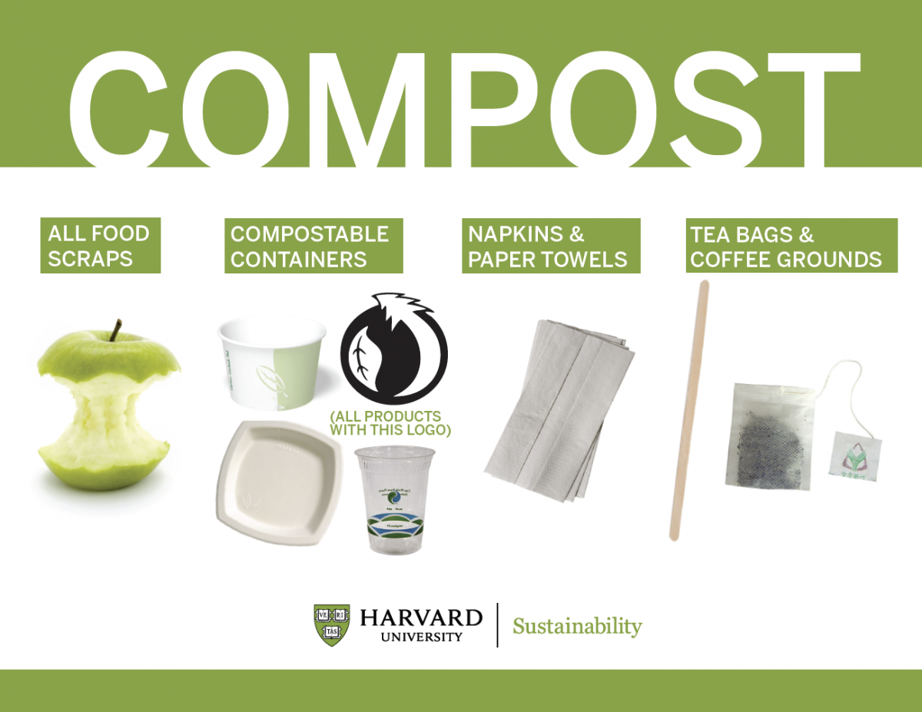
What Goes Where?
Greenware
Notes:
If composting isn’t available, Greenware (plant-based plastics, #7) should be thrown in the trash because they will contaminate the recycling facility.

Slide 6
What Goes Where?

